Slide 1
X Education
Lead Scoring Case Study
Group:
Balakrishna Gadiyar
Deepak Padhan
Bishnu Agrawal

Slide 2
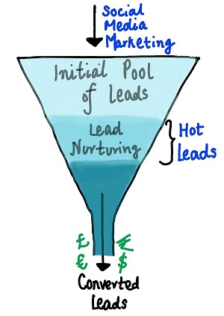
Abstract :
X Education sells online courses to industry professionals. Professionals who are interested in the courses land on their website and browse for courses. The company markets its courses on several websites and search engines like Google. Professionals fill up a form for the course which contain their email address or phone number, are classified to be a lead. Moreover, the company also gets leads through past referrals.
Sales team start making calls, writing emails, etc. Through this process, some of the leads get converted while most do not.
Problem Area -
The typical lead conversion rate at X education is around 30%, which is very low.
Objectives :
Build a model to using available lead data, assign a lead score to each of the leads such that the customers with higher lead score have a higher conversion chance and lower score with lower convrsion chance.
Business Recommendation - Target lead conversion rate to be around 80%.
Additional asks - Provide answers to business questions on lead and its features

Slide 3
Technical Approach
Understand the business process and problem
Identify the key features in given lead data.
Understand the data trends and record observations, decide the precition model to be logistic regression
Perform EDA –
Import, Understand data frame
Treat null values
Treat missing/wrong values
Drop fetures with no variations or which doesn’t contribute value while building model
Perform binary mapping for features with logical values, convert them to numbers
Generate dummy variables for columns with more than 2 values, convert them to columns, drop original features
Perform outlier analysis for the numeric columns and bring them in range.
Prepare for training – Split the data into training and testing groups
Scale the data before conducting RFE analysis
Plot correlation map and remove highly correlated features from train set. Repeat the process until a stable data frame is obtained
Build regression model and fit the train data and observe the parameters – p-value, coeffs,
Select the right features through RFE recommended ranking
Using statsmodel, asses the model and observe parameters,
Generate predicted values and review the trends, compare actual vs predicted
Generate confusion matrix, review model accuracy, turns out to be 80%
Verify VIFs, check how the feature variables are correlated with each other
Calculate sensitivity and specificity. Also calculate FPR, PPV, NPV
Plot ROC curve and find optimal cut off point, cacluate accuracy, sensitivity, probability and specificity for cut offs
Calculate precision and recall values, identify thresholds
Perform prediction on test sets
Calculate accuracy score, sensitivity and specificity values.

Slide 4
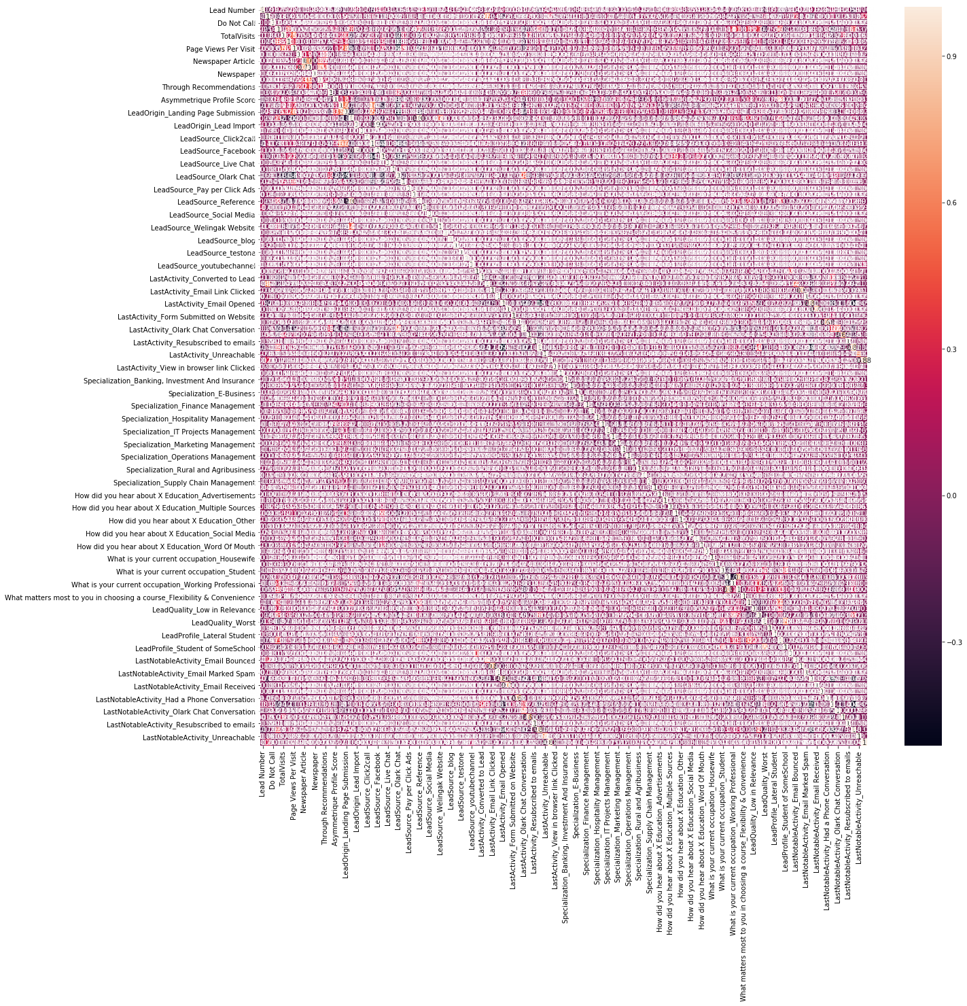
Correlations among origial features

Slide 5
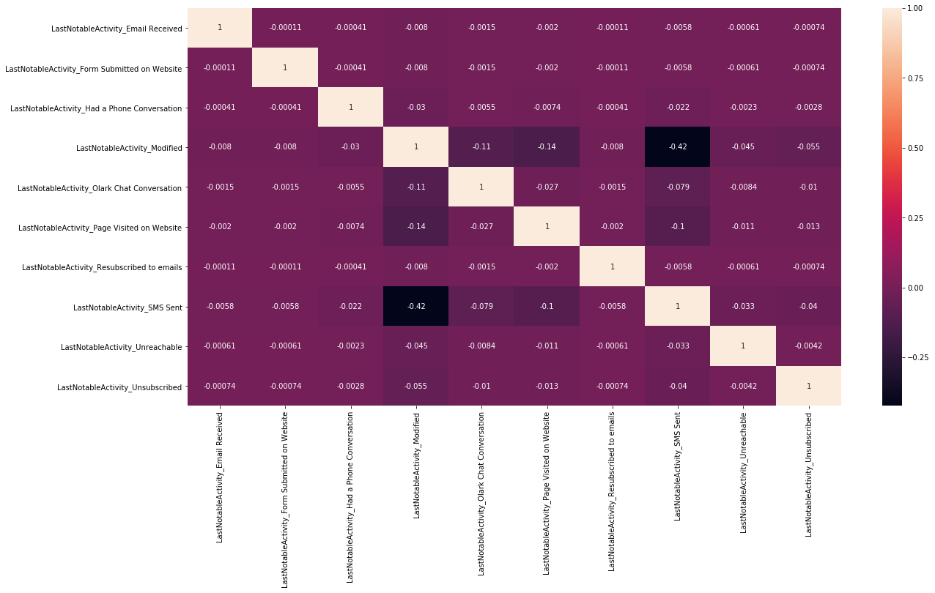
Revised Correlation after dropping High correlated features

Slide 6
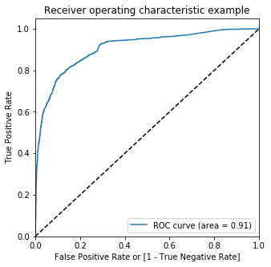
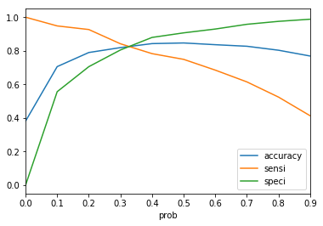
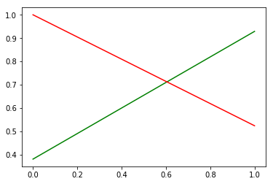
Logistic Regression - Visualizations
Accuracy Vs Sensitivity Vs Specificity
ROC
Threshold Curve

Slide 7
Business Questions
Which are the top three variables in your model which contribute most towards the probability of a lead getting converted?
What are the top 3 categorical/dummy variables in the model which should be focused the most on in order to increase the probability of lead conversion?
X Education has a period of 2 months every year during which they hire some interns. The sales team, in particular, has around 10 interns allotted to them. So during this phase, they wish to make the lead conversion more aggressive. So they want almost all of the potential leads (i.e. the customers who have been predicted as 1 by the model) to be converted and hence, want to make phone calls to as much of such people as possible. Suggest a good strategy they should employ at this stage.
Similarly, at times, the company reaches its target for a quarter before the deadline. During this time, the company wants the sales team to focus on some new work as well. So during this time, the company’s aim is to not make phone calls unless it’s extremely necessary, i.e. they want to minimize the rate of useless phone calls. Suggest a strategy they should employ at this stage.

Slide 8
Conclusion
Conclusion.

